Slide 1
PLAY FAIR CIPHER
Dr.A.Neela Madheswari
Professor,
Mahendra Engineering College

Slide 2
Introduction
Multiple-letter substitution cipher
Invented by Charles Wheatstone in 1854
Named after Lord Playfair (William Playfair - an engineer, founder of graphical methods of statistics, line, area, pie chart, etc) promoted the use of the cipher
Encrypt a pair of alphabets instead of single alphabet
Fast to use
Encryption –
1) key square generation – use key values first
2) Encryption – use rules for encryption

Slide 3
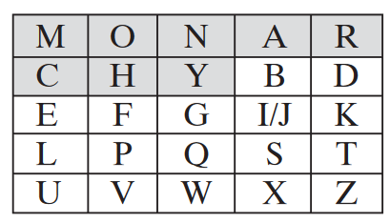
Key square generation
5 x 5 grid of alphabets
Out of 26 letters, J is excluded
The table is filled with key alphabets first
Example: MONARCHY
Make sure the letters are not repeated in the square

Slide 4
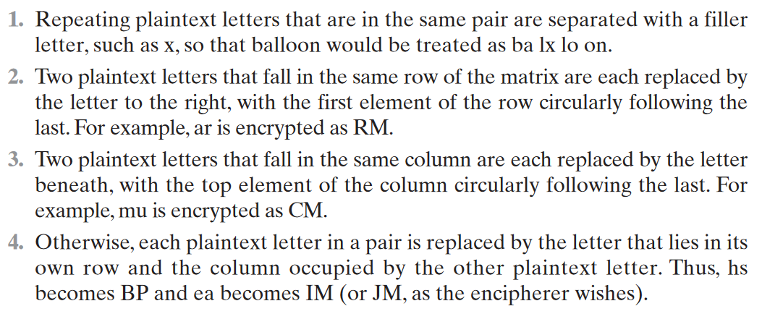
Encryption

Slide 5
Encryption
Split the plaintext first into pairs of two letters
If the plaintext has an odd number of letters, append the letter Z at the end
Example: If plain text is MANGO, for instance, consists of five letters
It is not possible to make a digraph
Change the plaintext to MANGOZ by adding the letter Z at the end

Slide 6
Encryption
Divide the plaintext into digraphs (pair of two letters)
For any letter that appears twice, place an X there (side by side)
Example: If the plaintext is COMMUNICATE, then it is divided as CO MX MU NI CA TE
For plaintext GREET, the digraph will be GR EX ET
For plaintext JAZZ, the digraph will be JA ZX ZX

Slide 7
Encryption - Example
Plain text – COMMUNICATE
Key – COMPUTER
Cipher text - ?

Slide 8
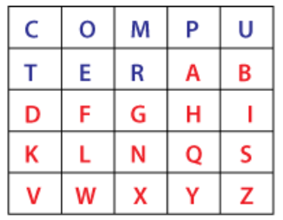
Encryption
In the plaintext, COMMUNICATE, M is repeated twice
Hence X is placed in between two Ms and make the plain text as COMXMUNICATE
Divide the plain text is pairs: CO MX MU NI CA TE
Fill the square 5 x 5 using key value first and the remaining letters later

Slide 9
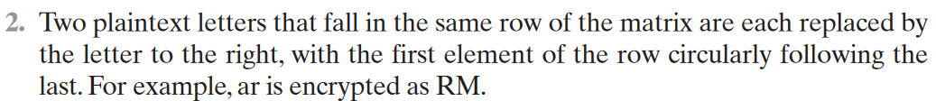
Encryption
CO MX MU NI CA TE
The first pair is CO. In the matrix, CO is in the same row
CO is enciphered into OM

Slide 10
Encryption
CO MX MU NI CA TE
The next pair is MX. In the matrix, MX is in the same column
MX is enciphered into RM

Slide 11
Encryption
CO MX MU NI CA TE
The next pair is MU. In the matrix, MU is in the same column
MU is enciphered into PC

Slide 12
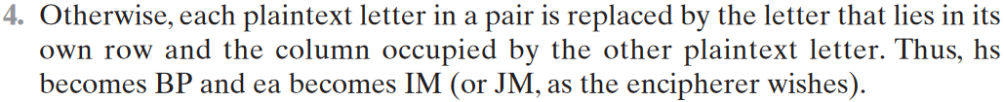
Encryption
CO MX MU NI CA TE
The next pair is NI. In the matrix, NI is in the different row and different column
NI is enciphered into SG

Slide 13
Encryption
CO MX MU NI CA TE
The next pair is CA. In the matrix, CA is in the different row and different column
CA is enciphered into PT

Slide 14
Encryption
CO MX MU NI CA TE
The next pair is TE. In the matrix, TE is in the same column
TE is enciphered into ER

Slide 15
Encryption
Plain text – COMMUNICATE
Key – COMPUTER
Cipher text – OM RM PC SG PT ER
The cipher text has even number of letters

Slide 16
Decryption
Use same 5 x 5 square key matrix with same values
The cipher text is split into pair of two letters
If both are in the same row, take the letter of each one
If both are in same column, take the letter above each one
If both are from different row and column, then form a rectangle, take the letters of horizontal opposite corner

Slide 17
Decryption - Example
Cipher text – OM RM PC SG PT ER
Key – COMPUTER
Plain text - ?

Slide 18
Decryption
OM RM PC SG PT ER
The first pair is OM
Both are in the same row
O’s left -> C
M’s left -> O
Deciphered text is CO

Slide 19
Decryption
OM RM PC SG PT ER
The next pair is RM
Both are in the same column
R’s top -> M
M’s top -> X
Deciphered text is MX

Slide 20
Decryption
OM RM PC SG PT ER
The next pair is PC
Both are in the same row
P’s left -> M
C’s left -> U
Deciphered text is MU

Slide 21
Decryption
OM RM PC SG PT ER
The next pair is SG
Both are in the different row and different column
SG’s opposite diagonal is NI
Deciphered text is NI

Slide 22
Decryption
OM RM PC SG PT ER
The next pair is PT
Both are in the different row and different column
PT’s opposite diagonal is CA
Deciphered text is CA

Slide 23
Decryption
OM RM PC SG PT ER
The next pair is ER
Both are in the same row
E’s left -> T
R’s left -> E
Deciphered text is TE

Slide 24
Decryption
Cipher text – OM RM PC SG PT ER
Key – COMPUTER
Plain text – CO MX MU NI CA TE

Slide 25
Play fair cipher
Aim:
To implement a Java program to encrypt a plain text and decrypt a cipher text using play fair cipher
Algorithm:
Read the key value from the user
Create the key table of 5x5 grid of alphabets
Read the plain text from the user for encryption
Insert x between double-letter digraphs and redefine the length for the plain text
Make the plain text of even length by adding X at the end if the plain text has odd number of characters
The plain text is split into pairs of two letters
If both the letters are from same row, take the letter to the right of each one
If both the letters are from same column, take the letter below of each one
If neither of the above two rules are true, form a rectangle with the two letters and take the letters on the horizontal opposite corner of the rectangle
Print the encrypted text in the screen
Use the encrypted text as input for decryption and the same key table of 5x5 grid of alphabets is considered
The cipher text is split into pairs of two letters
If both the letters are from same row, take the letter to the left of each one
If both the letters are from same column, take the letter above of each one
If neither of the above two rules are true, form a rectangle with the two letters and take the letters on the horizontal opposite corner of the rectangle
Print the decrypted text in the screen

Slide 26
Program for play fair cipher
import java.awt.Point;
class playfairCipher
{
private static char[][] charTable;
private static Point[] positions;
private static String prepareText(String s, boolean chgJtoI)
{
s = s.toUpperCase().replaceAll("[^A-Z]", "");
return chgJtoI ? s.replace("J", "I") : s.replace("Q", "");
}

Slide 27
private static void createTbl(String key, boolean chgJtoI)
{
charTable = new char[5][5];
positions = new Point[26];
String s = prepareText(key + "ABCDEFGHIJKLMNOPQRSTUVWXYZ",chgJtoI);
int len = s.length();
for (int i = 0, k = 0; i < len; i++)
{
char c = s.charAt(i);
if (positions[c - 'A'] == null)
{
charTable[k / 5][k % 5] = c;
positions[c - 'A'] = new Point(k % 5, k / 5);
k++;
}
}
}

Slide 28
private static String codec(StringBuilder txt, int dir)
{
int len = txt.length();
for (int i = 0; i < len; i += 2)
{
char a = txt.charAt(i);
char b = txt.charAt(i + 1);
int row1 = positions[a - 'A'].y;
int row2 = positions[b - 'A'].y;
int col1 = positions[a - 'A'].x;
int col2 = positions[b - 'A'].x;
if (row1 == row2)
{
col1 = (col1 + dir) % 5;
col2 = (col2 + dir) % 5;
}

Slide 29
else if (col1 == col2)
{
row1 = (row1 + dir) % 5;
row2 = (row2 + dir) % 5;
}
else
{
int tmp = col1;
col1 = col2;
col2 = tmp;
}
txt.setCharAt(i, charTable[row1][col1]);
txt.setCharAt(i + 1, charTable[row2][col2]);
}
return txt.toString();
}

Slide 30
private static String encode(String s)
{
StringBuilder sb = new StringBuilder(s);
for (int i = 0; i < sb.length(); i += 2)
{
if (i == sb.length() - 1)
{
sb.append(sb.length() % 2 == 1 ? 'X' : "");
}
else if (sb.charAt(i) == sb.charAt(i + 1))
{
sb.insert(i + 1, 'X');
}
}
return codec(sb, 1);
}

Slide 31
private static String decode(String s)
{
return codec(new StringBuilder(s), 4);
}
public static void main(String[] args) throws java.lang.Exception
{
String key = "COMPUTER";
String txt = "COMMUNICATE";
/* make sure string length is even */
/* change J to I */
boolean chgJtoI = true;
createTbl(key, chgJtoI);
String enc = encode(prepareText(txt, chgJtoI));
System.out.println("Simulating Playfair Cipher \n--------");
System.out.println("Input Message : " + txt);
System.out.println("Encrypted Message : " + enc);
System.out.println("Decrypted Message : " + decode(enc));
}
}

Slide 32
Output
Simulating Playfair Cipher
--------
Input Message : COMMUNICATE
Encrypted Message : OMRMPCSGPTER
Decrypted Message : COMXMUNICATE
Result:
Thus the play fair cipher is implemented using Java and is executed successfully.

Slide 33
William Stallings, “Cryptography and Network Security : Principles and Practices”, Sixth Edition, Prentice Hall, 2014
https://www.javatpoint.com/playfair-cipher-program-in-java
https://www.geeksforgeeks.org/playfair-cipher-with-examples/
https://intellipaat.com/blog/playfair-cipher/

